Slide 1
The Edge of Innovation: 5G Edge Computing
Welcome! Today, we explore 5G Edge Computing, a transformative technology shaping the future of IT. Get ready to discover its potential to revolutionize various industries!

Slide 2

Cloud Computing Limitations
Limited processing power at centralized locations increases latency.
Bandwidth limitations due to ever-growing data demands.
Security concerns with centralized data storage.
Traditional cloud computing faces challenges. Centralized processing power can cause delays (latency) for real-time applications. The increasing amount of data strains network bandwidth, leading to congestion. Additionally, centralized data storage raises security risks.

Slide 3

5G Edge Computing: A Shift
Processing power closer to data sources minimizes latency.
Reduced network congestion due to local data processing.
Potential for enhanced security with data processing at the edge.
5G Edge Computing disrupts the traditional model. It brings processing power closer to where data is generated (e.g., cell towers, devices) This distributed approach minimizes latency, crucial for real-time applications. Local data processing also reduces network congestion and potentially improves security.

Slide 4

Benefits of 5G Edge Computing
Reduced latency: Faster data processing for quicker response times.
Enhanced bandwidth: Improved data transfer speeds for data-intensive applications.
Increased connectivity: Better connectivity for devices with limited processing power.
Speaker Notes 5G Edge Computing offers significant benefits. Reduced latency allows for faster responses in real-time applications. Enhanced bandwidth empowers applications that generate massive amounts of data. Increased connectivity improves the performance of devices with limited processing power.

Slide 5
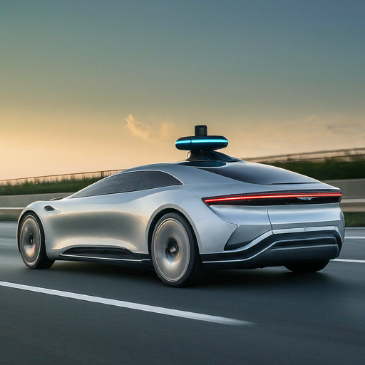
Transforming Industries
Self-driving cars: Real-time data processing for faster decision-making and enhanced safety.
Remote surgery: Reduced latency for real-time feedback and precise instrument control.
Smart factories: Predictive maintenance and optimized production through real-time data analysis.
Speaker Notes 5G Edge Computing transforms various industries. Self-driving cars leverage it for faster decision-making, leading to improved safety. Remote surgery benefits from reduced latency, allowing for more precise operations. Smart factories utilize 5G Edge Computing for real-time data analysis, enabling predictive maintenance and optimized production.

Slide 6
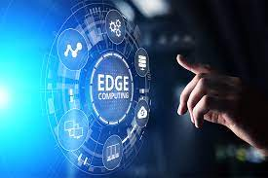
THANK YOU !!

